Slide 2
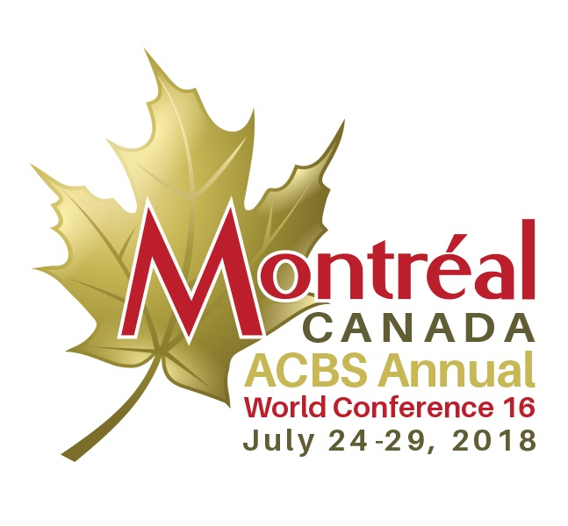
Need CE credit for this session?
Please don’t forget to sign in,
in order to have your
attendance tracked

Slide 3
Continuing Education Commercial Disclosure Requirement
The following presenters of this CE activity have financial relationships with commercial interests to disclose:
Fabian Olaz, Ph.D.
Book Royalties: New Harbinger
Matthieu Villatte, PhD
Book Royalties: Guilford Press
Notes:
Examples of third wave CBT interventions include ACT, DBT; MBCT and meta-cognitive approaches, among others. Rather than focusing on changing psychological events
Rather than seeking to change form or frequency of internal events (i.e., symptoms), seek to change the function of those events and the individual’s relationship to them through strategies such as mindfulness, acceptance, or cognitive defusion (Teasdale, 2003).

Slide 4
RFT: A Contextual Behavioral approach to language and cognition

Slide 5
So, what is Clinical RFT?
→ Using RFT principles to make language a clinical tool
Notes:
So, clinical RFT is the application of RFT in clinical work. It means we are using RFT principles to turn language into a clinical tool.

Slide 6
Language is a Behavior
Notes:
From a Contextual Behavioral point of view LANGUAGE is a behavior or a behavioral repertoire that allows us to be where we are, and to solve many difficult problems in our life. In fact, we can say that Language is an evolutionary selected repertoire that it is present with us because of its utility for surviving. Beautiful, isn’t it?

Slide 7
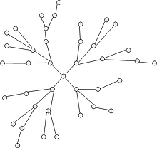
Language/cognition is the learned behavior of building and responding to symbolic relations between events.
Notes:
So, RFT is a behavioral theory of language and cognition. And the way language and cognition are approached in RFT is as a learned behavior of building and responding to symbolic relationship among things. Remember that relating is not other thing that responding to one event I terms of another. It’s not a technical definition, but it is consistent enough with the more technical definitions you will find

Slide 8
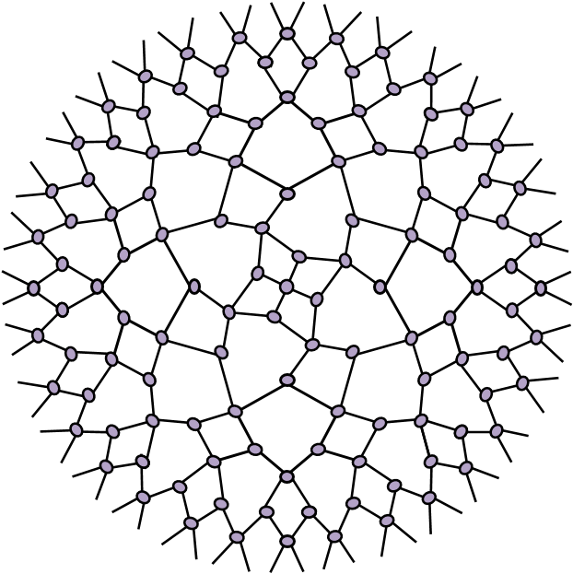
A
B
C
Languaje
Notes:
So I said that language is a behavior so it is an act in context. As so it is, it is influenced by antecedents and consequences, and is shaped by means of contingencies that socioverbal community arranges.

Slide 9
Language is also a context
Notes:
But language is also a context, because once we acquire this repertoire, we are able to relate every event with every other (WHAT WE CALL FFRAMING), and not only based on intrinsic or physical properties of them, but also in terms of symbolic features (that is why we usually say that these relations are arbitrarily applicable)

Slide 10
A
B
C
Language
Language
Notes:
Another way of saying this is that once we acquire language our behavior and other ways of learning behavior can be influenced by symbolical antecedents and consequences, building relational networks or stories and rules that will influence what we do, and the way we respond to events

Slide 11
Using language we can frame our experiences in different ways transforming their impact or influence
Notes:
So, AS AN EXAMPLE, YOU CAN SEE THIS PICTURE OF A HANDSOME GUY, AND IN THE SAME WAY WE CAN FRAME THIS PICTURE IN DIFFERET FRAMES INFLUENCING IN THE IMPACT THAT THE PICTURE HAS, we can frame experiences in different ways and change their impact.

Slide 12
The bottle of water Dilemma
LSD
Yucky stuff
filthy fluids
Notes:
The metaphor of framing is what gave RFT its name, relational frame theory. Building symbolic relations among experiences is like framing these experiences and giving them various meanings. There are different types of framing, which can change the meaning or impact of experiences in different ways. As a final example lets talk about the bottle of water dilemma

Slide 13
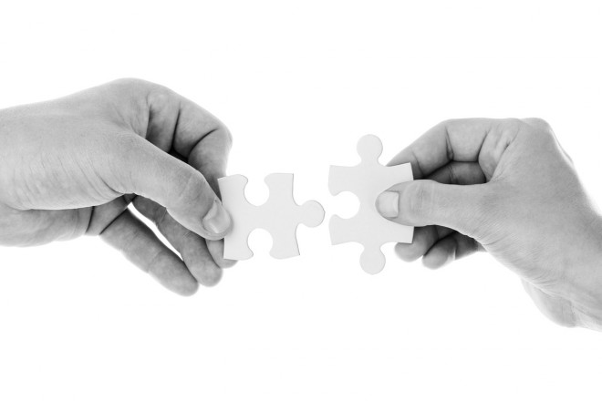
Using RFT in therapy
FRAMEWORK
OVERARCHING GOALS
Flexible context sensitivity
Functional coherence
OVERARCHING STRATEGY
Transforming symbolic functions
→ by altering the context
Notes:
Let’s summarize the RFT framework to use language in therapy. We have two overarching goals: flexible context sensitivity and functional coherence, and an overarching strategy: transforming symbolic functions by altering the context, to move toward these two overarching goals.

Slide 14
Overarching Goals
Shape flexible context sensitivity:
Capacity to notice various features of the context and to respond to what is most relevant.
Shape functional coherence:
Thinking and making choices based on wholeness and effectiveness, so that actions are taken in the service of meaningful living.

Slide 15
Using RFT in therapy
LANGUAGE TOOLS
Coordination & distinction
Opposition
Comparison
Condition
Deictic
Hierarchy
Combination of relations
Notes:
Then we have the concrete tools of language, made of different types of framings and combinations of framings. Using the different types of framing alters the context in different ways and can lead to different types of transformations of functions.

Slide 16
4 Guiding Principles
Experiential (rather than didactic)
Pragmatic/Functional (rather than essential/social coherence)
Integrative (rather than suppressive)
Contextual (rather than mechanistic)
Notes:
Before finishing lets talk about the basis of our work, or the guiding principles. We have 4 guiding principles. The first one implies that we have to prioritize an experiential approach, and I want to highlight just one thing. Being experiential is not about avoiding the stories that our client presents in the room, invalidating them because we learnt that content is not important. In some contexts content is important without any doubt, and in fact, we can evoke a very experiential conversation using some principles derived from RFT. The second one is about fostering Functional or pragmatic coherence, what means that we are not interested in the truth of our clients stories, but in how workable they are regarding what is meaningful to them
As you know, we assume that we can not take any behavior out of our repertoire, that is way our approach is integrative rather suppressive (our stance is a “yessing stance”). Finally, we are not interested in removing or changing broken peaces of machines, but in influencing in Behaviors INFLUENCING IN THEIR CONTEXT, in this particular approach, the verbal context

